Slide 1
PAku
Park & Walk
Smart Parking System

Slide 2
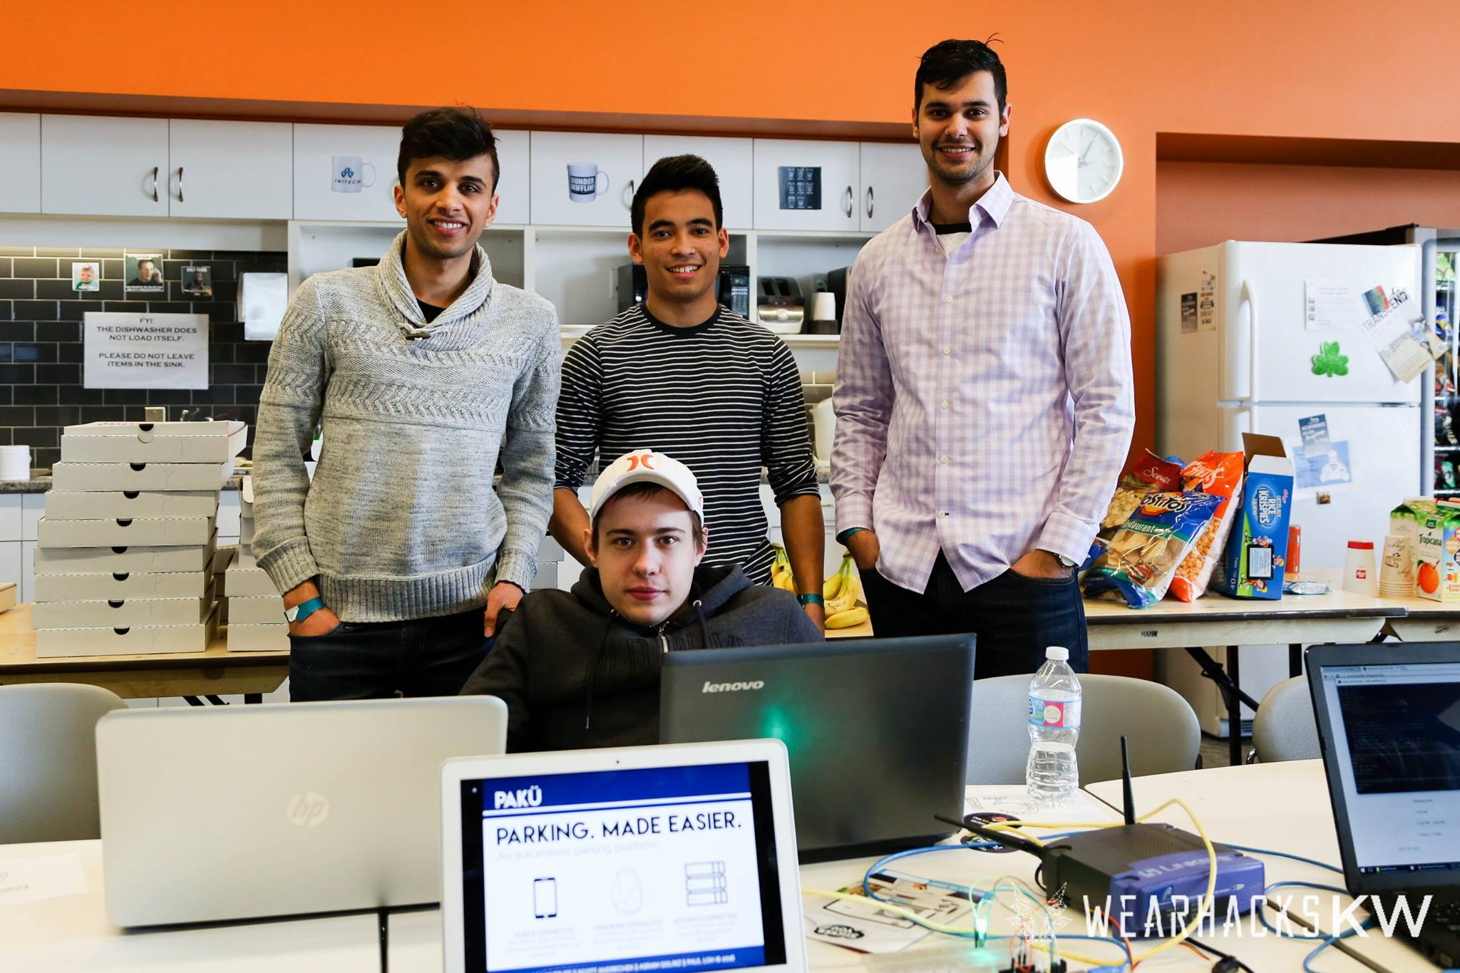
March 2016 Waterloo Wearable & IoT Hackathon

Slide 3
Team
Arsam
Electrical
Engineer
Hrishi
Computer
Science
Paul
Computer
Engineer
Scott
Computer
Science

Slide 4
Overview
Paku
(On-Street Park & Walk System)
Smart Parking
Meter
License Plate Recognition
Software Infrastructure & Environment
Paku is an Internet of Things opportunity!

Slide 5
VISION
“Parking will be a hands-free,
completely automated
transaction”
Charging based on exact parking duration
Almost eliminates need for enforcement
Includes benefits of other smart parking meter solutions: demand-based pricing, parking guidance map apps, management analytics, etc.
A smartphone is not even needed!

Slide 6
Market Opportunity
Parking is a $100 billion per year market globally ¹
Smart parking segment was $40 million in 2015, with expected CAGR of 26% ²
On-street parking represents 1/3 of parking revenues and controlled by cities & municipalities
Existing “smart” parking meters cost $500 - $1000 per meter
Business model: Infrastructure As A Service (IaaS)
¹ Frost & Sullivan
² Navigant Research

Slide 7
Existing Related Solutions
“Smart” parking meters: meters with payment options (e.g. coin, card or phone)
Parking spot occupancy sensors
Off-Street (i.e. parking lot) physical parking guidance systems
Smartphone apps mapping available parking spots, price and allowing reservations
License Plate Recognition systems are in wide use, e.g. police vehicles, highway toll collection

Slide 8
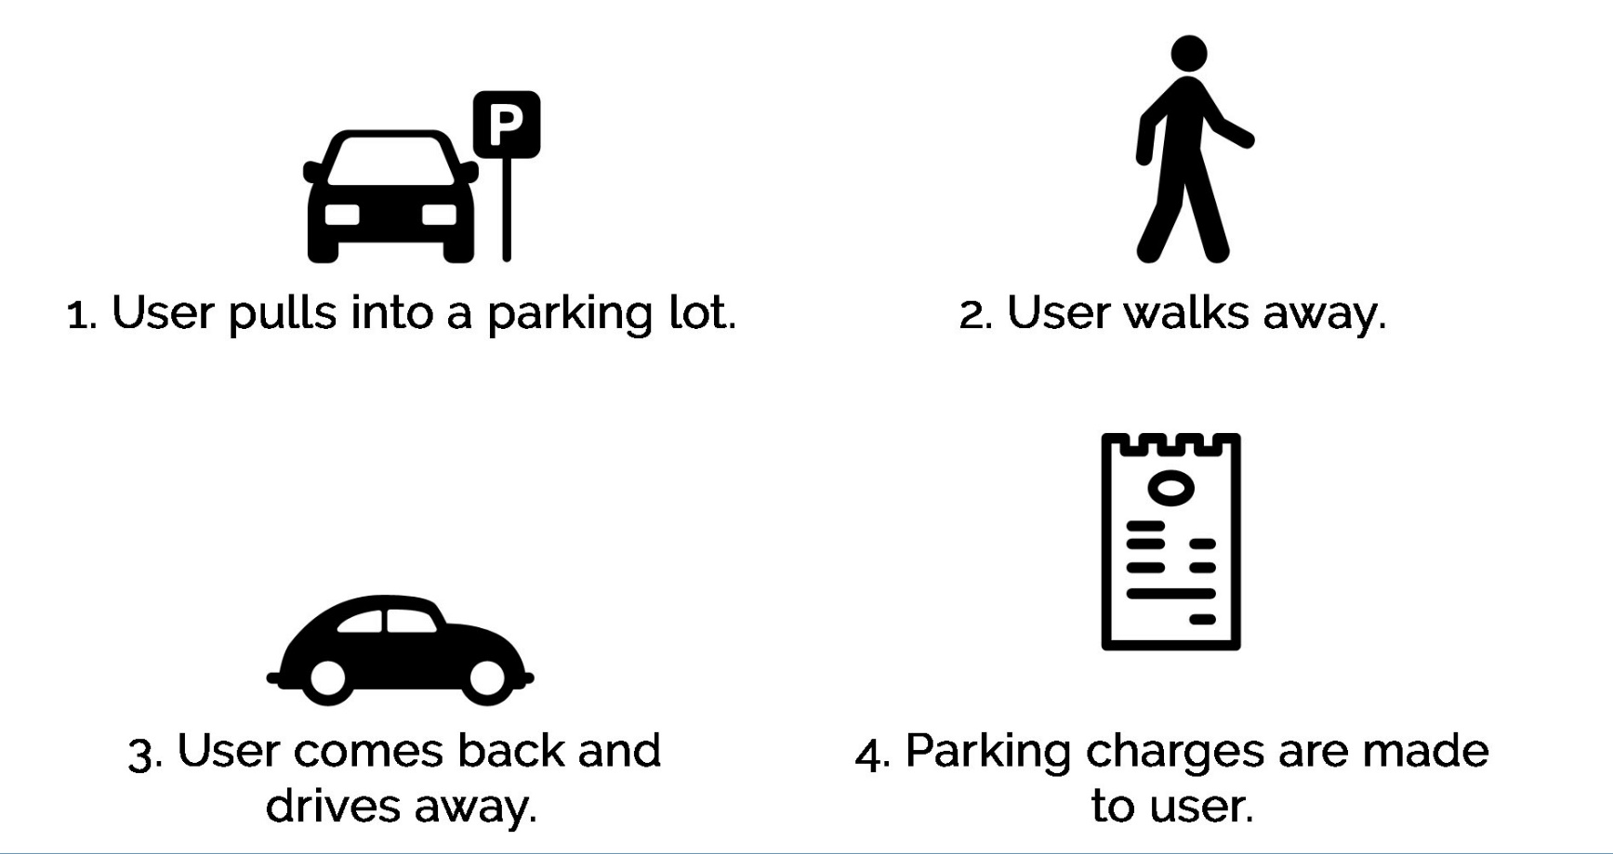
Typical User Experience

Slide 9
PAKU SYSTEM
License plate recognized using low-cost camera and software
Accesses cloud-based CMS and checks that customer has an account
An entry is made in customer’s account, recording time and parking spot
Large LED on parking meter turns green, indicating that customer is good to park & walk
Car driving away is recognized, CMS system is accessed to record departure time
Email receipt is sent to customer
Design focus will be on “edge cases”, including new customer and camera blockage scenarios

Slide 10
Challenges
Privacy
Intellectual property
Decreased revenue from fines
Not capital light
Limited time, given school

Slide 11
Time Frames & Next Steps
Time Frame
4-6 months for a prototype
1 year after prototype for pilot
Next steps
Development of optical character recognition

